Slide 1


CRIME FORCASTING USING CLUSTERING TECHNIQUES
Guided By: Presented By:
Prof. Sunnie Chung Shah Dhrumil 2860168
Shrivastava Kajal 2861721

Slide 2

Agenda
Goal of the Analysis
Data Description
Feature Selection
Platforms/System Tools
Preprocessing and Transformation Methods
Clustering
Model Evaluation
Accuracy and Comparisons
Discussion and Conclusions
References

Slide 3

Goal of the Analysis
Investigation of the Crime
The goal is to examine:
The types of crime.
If there are correlations between the incidents and the areas.
For analysis, three clustering algorithms
Evaluating the result with silhouette score or accuracy of each algorithm.

Slide 4
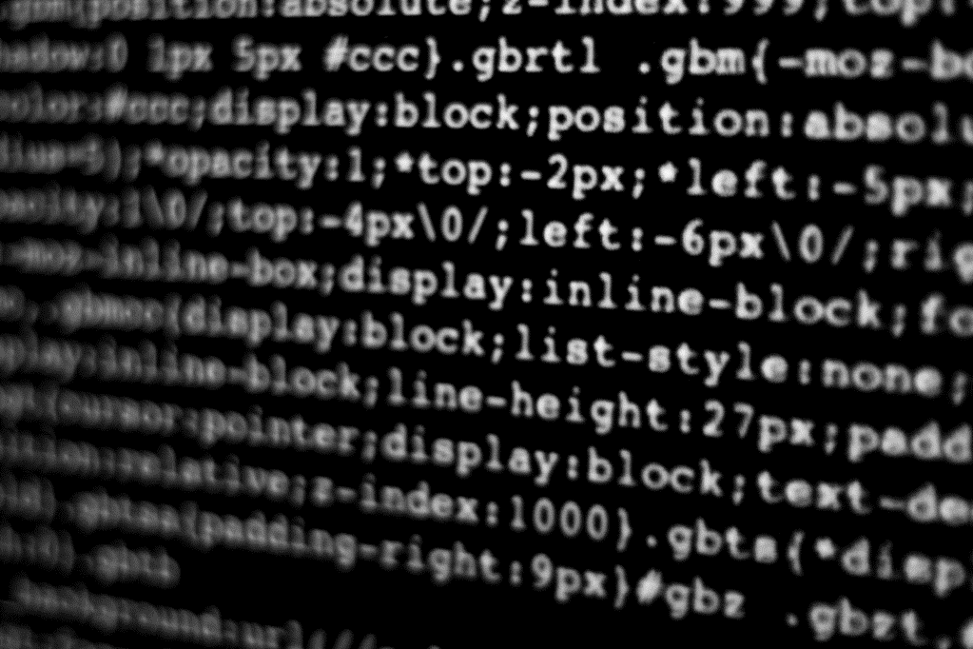
Data DESCRIPTION
Dataset: NIJ(National Institute of Justice)
Time frame: NIJ2015_Jan01_Dec31
2015, full year (zip, 13.8 MB) — posted September 1, 2016
https://nij.ojp.gov/funding/real-time-crime-forecasting-challenge-posting#data
Consists of 8 columns and total 208084 entries.
Columns have entries such as person crime, traffic, property crime, criminal/admin, non-criminal and disorder which will help to analyze the types of crime.
CATEGORY | Nominal | Discrete
CALL GROUPS | Nominal | Discrete
Final_case_type | Nominal | Discrete
CASE DESC | Nominal | Discrete
occ_date | interval | Discrete
X_coordinate | Ratio | Continuous
Y_coordinate | Ratio | Continuous
Census_tract | Nominal | Discrete

Slide 5
Feature Selection
How is feature selection done?
Using the Filter Method(Correlation-based method):
Selecting the relevant features from the set of all the features, that could impact the target variable and hence, the result of analysis.
We have taken 3 features for the prediction which includes:
CATEGORY | Nominal | Discrete
X_coordinate | Ratio | Continuous
Y_coordinate | Ratio | Continuous

Slide 6
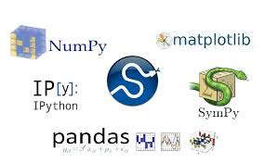


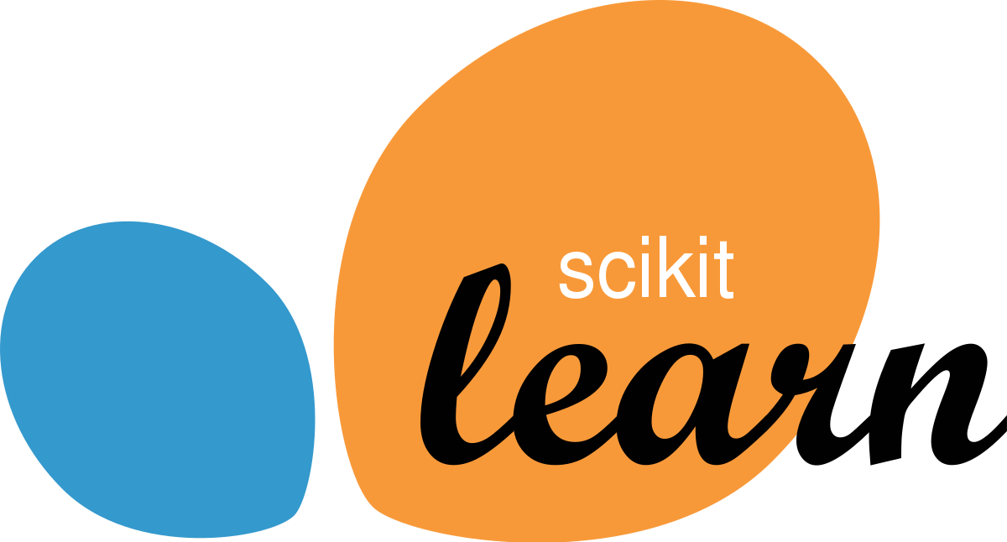
Platform/System Tools
NumPy: Fundamental package for numerical computing with support for large, multi-dimensional arrays and matrices.
SciPy: Library for scientific and technical computing, built on NumPy. It includes modules for optimization, integration, interpolation, eigenvalue problems, and more.
Pandas: Data manipulation and analysis library, providing data structures like DataFrame.
Matplotlib: 2D plotting library for creating static, animated, and interactive visualizations in Python.
Scikit-learn: Simple and efficient tools for data mining and data analysis. It includes various machine learning algorithms and tools for tasks such as classification, regression, clustering, and more.

Slide 7
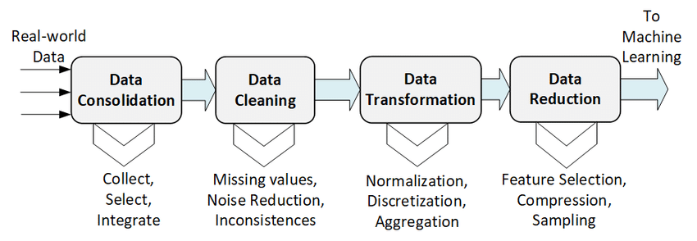
Data Preprocessing And Transformation
4. Handling OUTLIERS
Handling NULL values
2. BINARIZATION and STANDARDIZATION
3. NORMALIZATION
5. FEATURE SELECTION
Converting numerical values into binary values (0 or 1) based on a threshold.
It Ensures all features have a similar scale, preventing dominance by features with larger numeric ranges.
Convert the data in the range of 0 to 1 which will give the same scale to every features. This will enhance the model performance.
It refers to the process of identifying and managing data points that deviate significantly from the majority of the observations in a dataset.
Common methods include z-scores, the IQR (Interquartile Range) method, or visualizations such as box plots and scatter plots.
Selecting the relevant features from the set of all the features, that could impact the label.
Managing missing or null values in a dataset.
Replacing null values with estimated or calculated values (mean, median, mode).

Slide 8
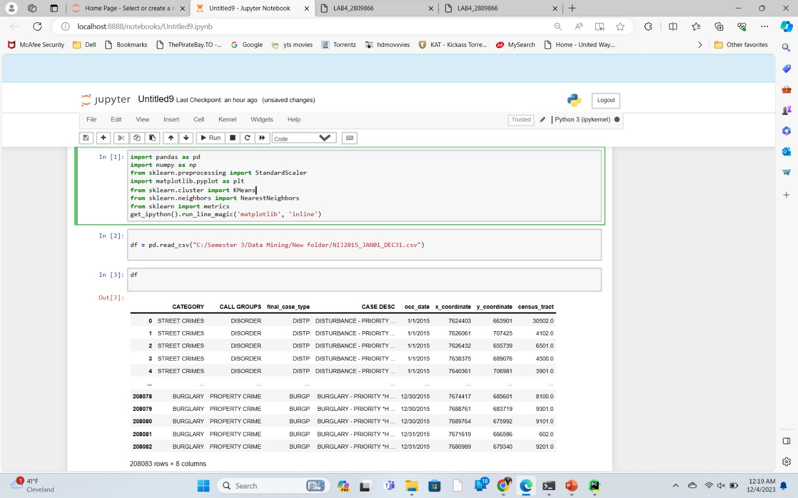
Importing and Reading the CSV File

Slide 9
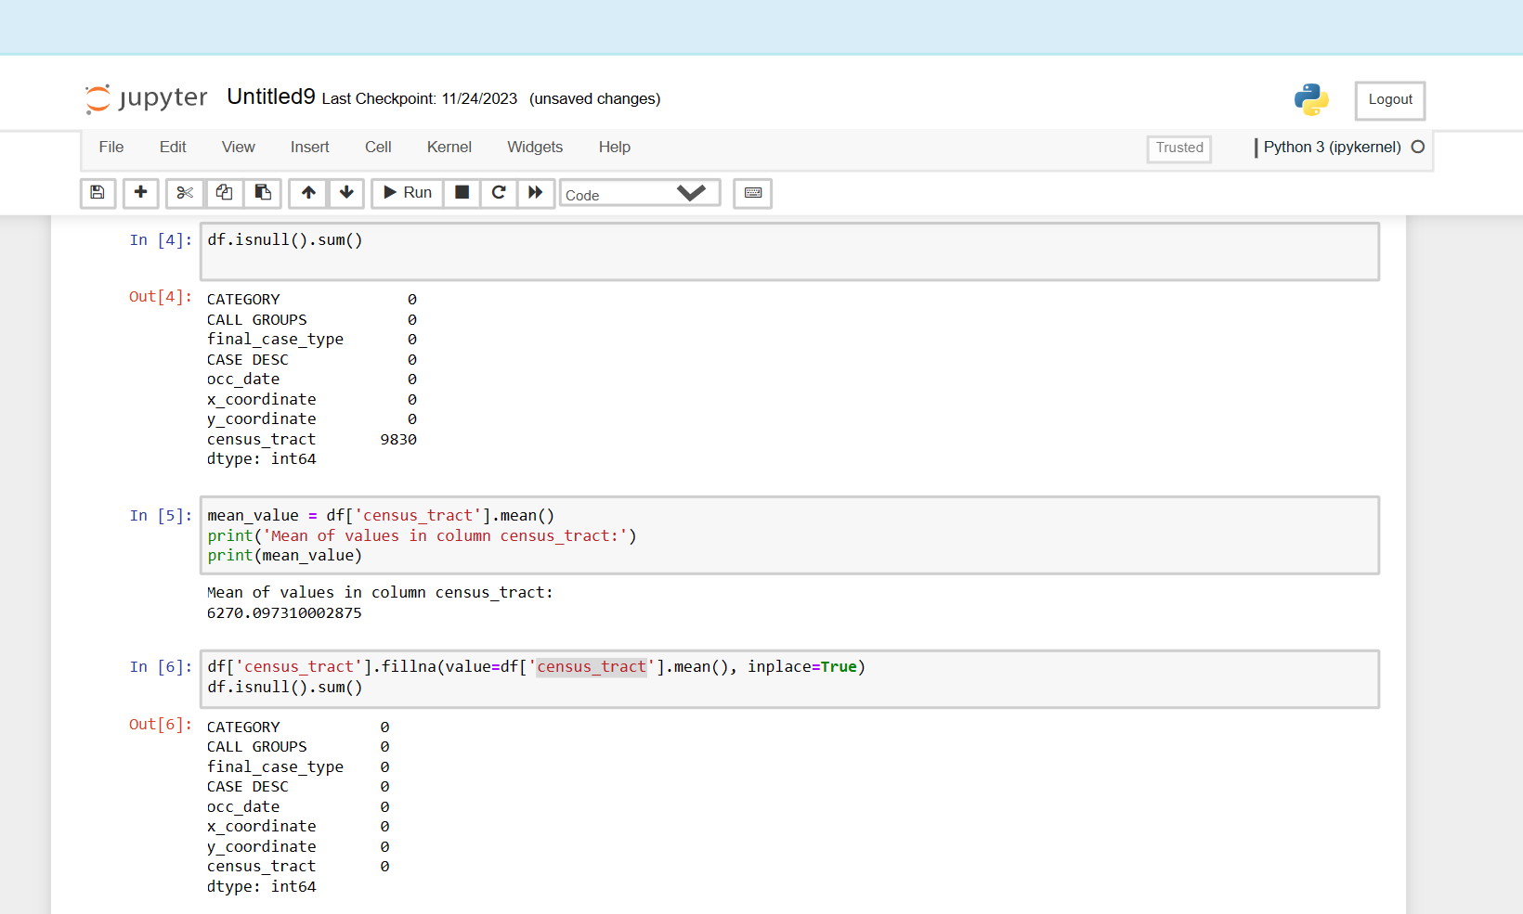
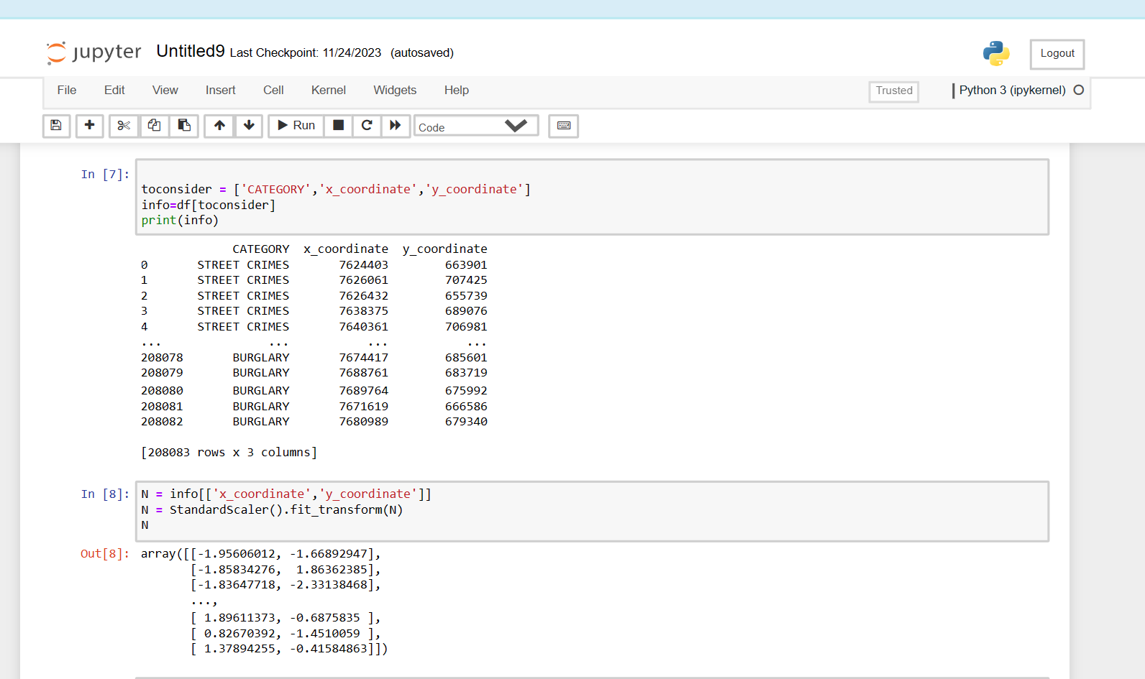
Source Code For Data Preprocessing and Transformation
Finding any null value, if found replaced it by mean value.
Selecting features
Used standardization for pre processing of
continuous data.

Slide 10
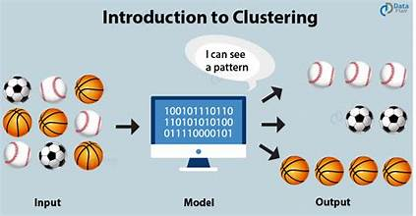
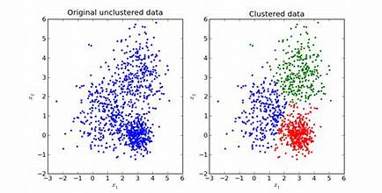
What is clustering??
It is basically a collection of data points on the basis of similarity and dissimilarity between them.
Clustering is the task of dividing the population or data points into a number of groups such that data points in the same groups are more similar to other data points in the same group and dissimilar to the data points in other groups.
The idea is that items in the same group are more alike or related to each other than to items in other groups.
For example The data points in the graph clustered together can be classified into one single group. We can distinguish the clusters, and we can identify that there are 3 clusters in the picture

Slide 11

K-means clustering
An unsupervised learning algorithm
Consider given a data set of items, with certain features and labels
Task is to categorize those items into groups. To achieve this, we will use the K-means algorithm.
Here, ‘K’ represents the number of groups/clusters we want to classify our items into.
Categorize the items into k groups or clusters of similarity.
To calculate that similarity, we will use the Euclidean distance as a measurement.
K-means Clustering — scikit-learn 1.0.1 documentation.

Slide 12
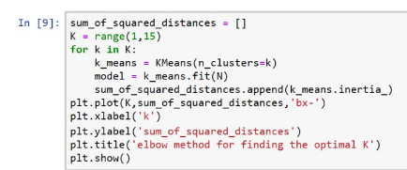
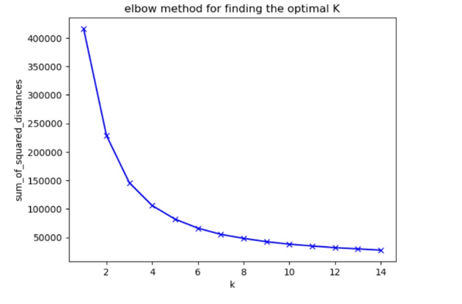
KNN-Clustering
finding optimal K value ( number of cluster using elbow method)

Slide 13
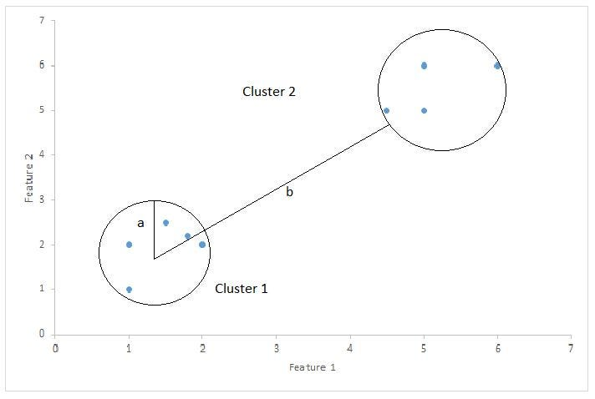
What is silhouette score??
Silhouette Coefficient or silhouette score is a metric used to calculate the goodness of a clustering technique. Its value ranges from -1 to 1. 1: Means clusters are well apart from each other and clearly distinguished.

Slide 14
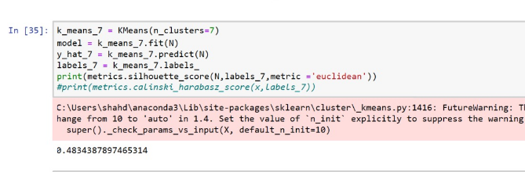
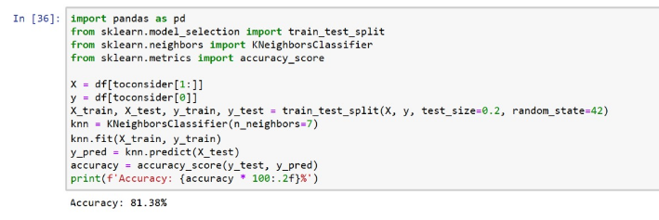
Size of Training and Testing Set KNN-Accuracy
silhouette score is 0.4834 for cluster = 7.
Training Data = 80%, Testing Data = 20%
accuracy of train set and test set for KNN= 81.38%

Slide 15
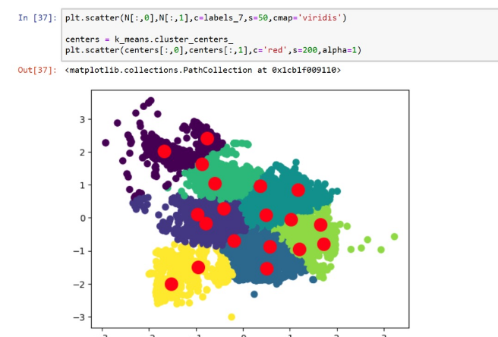
Scatter Plot for Knn

Slide 16
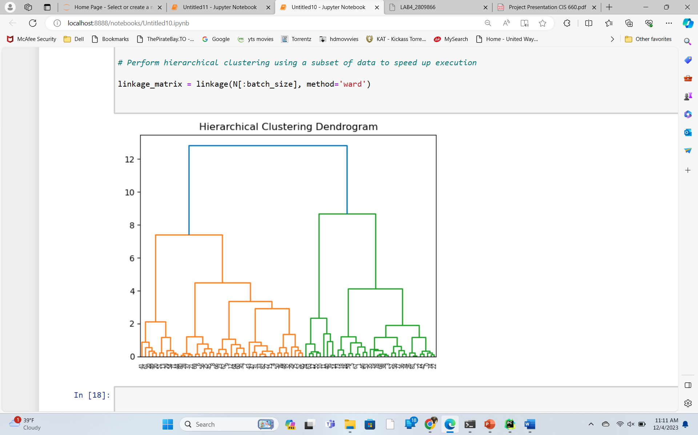
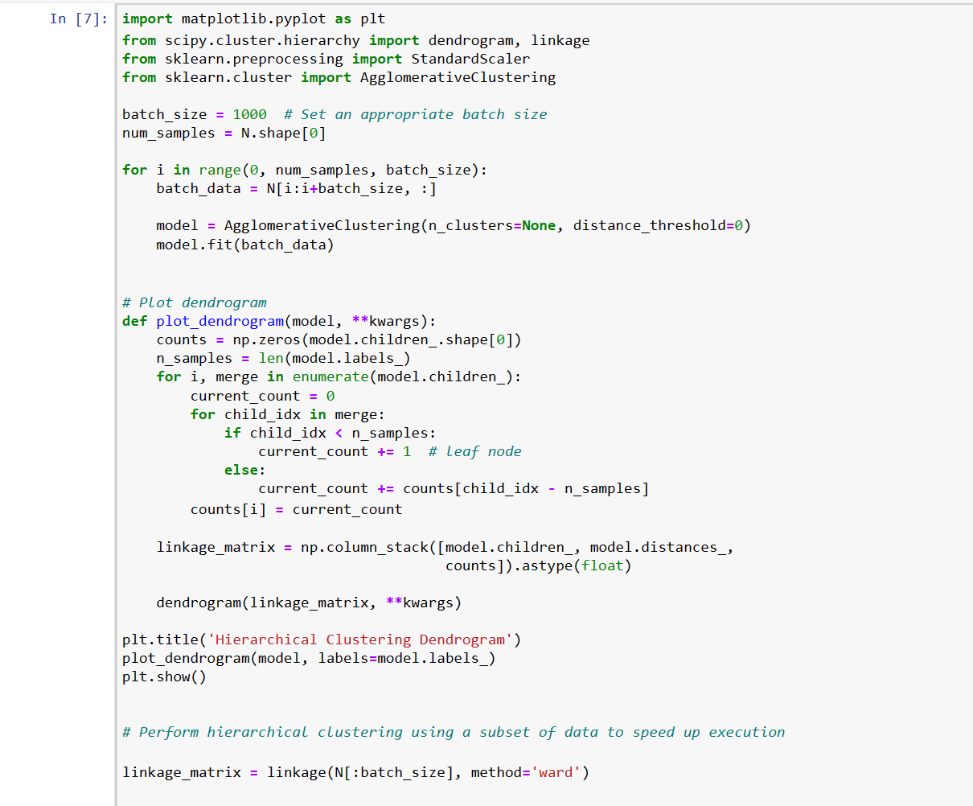
Hierarchical Clustering
Hierarchical clustering is a method of cluster analysis that builds a hierarchy of clusters.
This type of clustering can be represented as a tree-like structure known as a dendrogram, which illustrates the arrangement of clusters and the relationships between them.

Slide 17
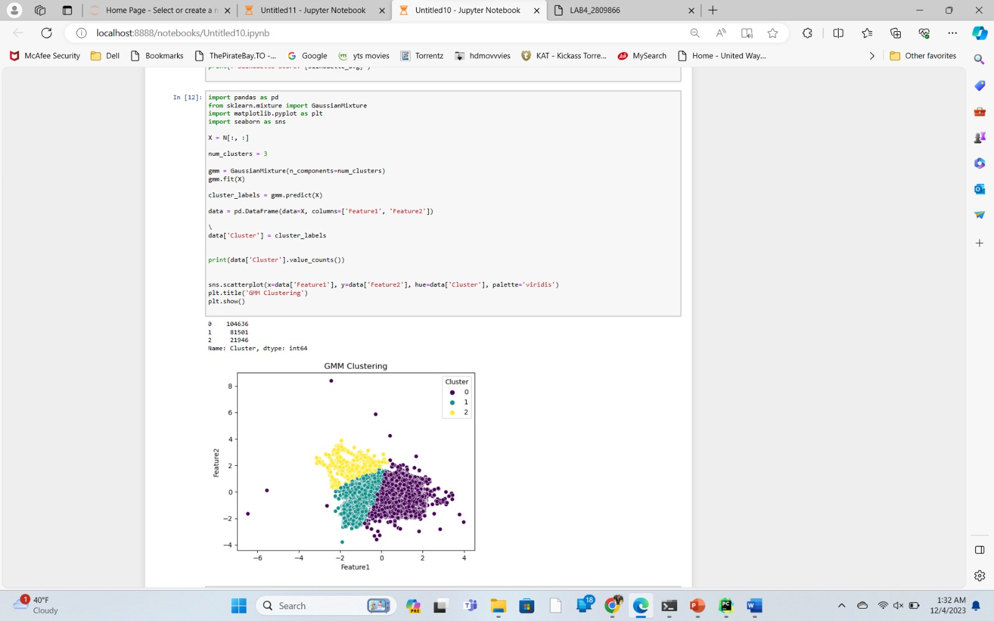
Gaussian Mixture
A Gaussian Mixture Model (GMM) is a probabilistic model commonly used for clustering and density estimation.
It assumes that the data is generated by a mixture of several Gaussian distributions (bell-shaped curves).
Each Gaussian component in the mixture represents a cluster, and the overall model is a combination (mixture) of these Gaussians.
https://scikit-learn.org/stable/modules/generated/sklearn.mixture.GaussianMixture.html

Slide 18
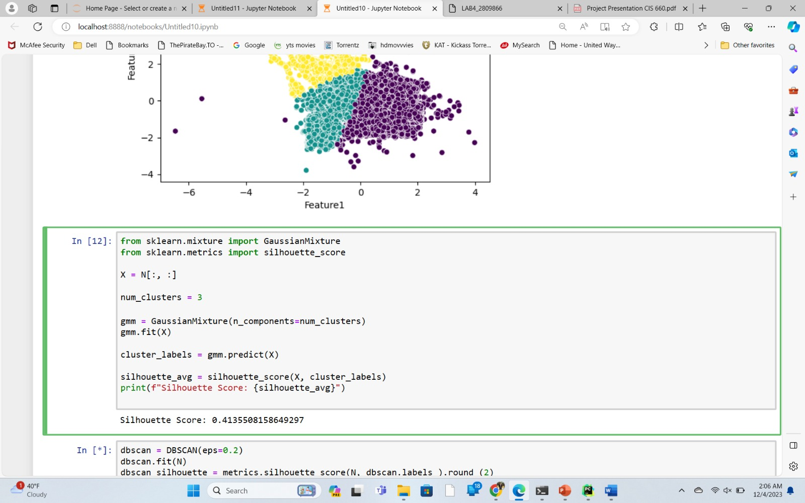
Silhouette Score for Gaussian Mixture
Silhouette score is 0.4135508

Slide 19
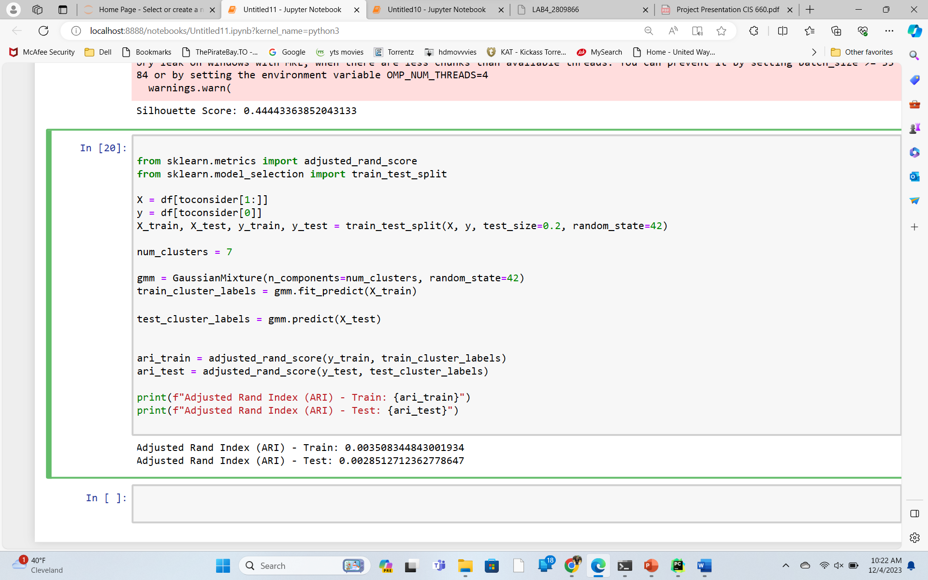
Accuracy of Gaussianmixture using adjusted rand index(ari)
ARI test: 0.002851
ARI train:0.003580

Slide 20

Conclusion
From the above experiment we found that k-means clustering has 81.38% accuracy and silhouette score is 0.4835.
However, gaussian mixture(gmm) has 0.0031 ari accuracy and 0.4125 silhouette score.
From this we can conclude that k-means algorithm is much more reliable as compare to the GMM.

Slide 21
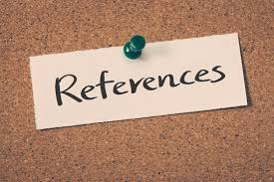
https://scikit-learn.org/stable/modules/generated/sklearn.mixture.GaussianMixture.html
K-means Clustering — scikit-learn 1.0.1 documentation.
https://www.geeksforgeeks.org/k-nearest-neighbours/

Slide 22
Thank You
Your Questions are Welcome?

